Slide 1
ADO_.NET PROJECT

Slide 2
Introduction
ADO.NET consists of classes that can be used to connect,retrieve,insert and delete data.
ADO.NET has two main components that are used for Accessing and Manipulating data.
All the ADO.NET classes are located into System.Data.dll.

Slide 3
.NET Data Providers Objects
Connection: IT is used to establish a connection to a specific source.
Command: It is used to execute queries to perform database operations.
DataReader: It is used to read data from data source.
DataAdapter: It populates a DataSet and resolves updates with the Data source.

Slide 4
Data provider for sql server
SqlConnection: It is used to create SQL Server Connection.
SqlCommand: It is used to execute database queries.
SqlDataAdapter: It represents a set of data commands and a database connection that are used to fill the data set.
SqlDataReader: It is used to read rows from a SQL Server database.
SqlException: It throws an exception when an error is occurred.

Slide 5
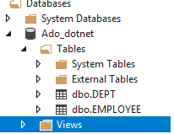
Sql server connectivity
Creating Database
Now,create database by selecting database option .
After creating database,let’s create a table.
In this source code,we are using created Employee database and Department database to connect.

Slide 6
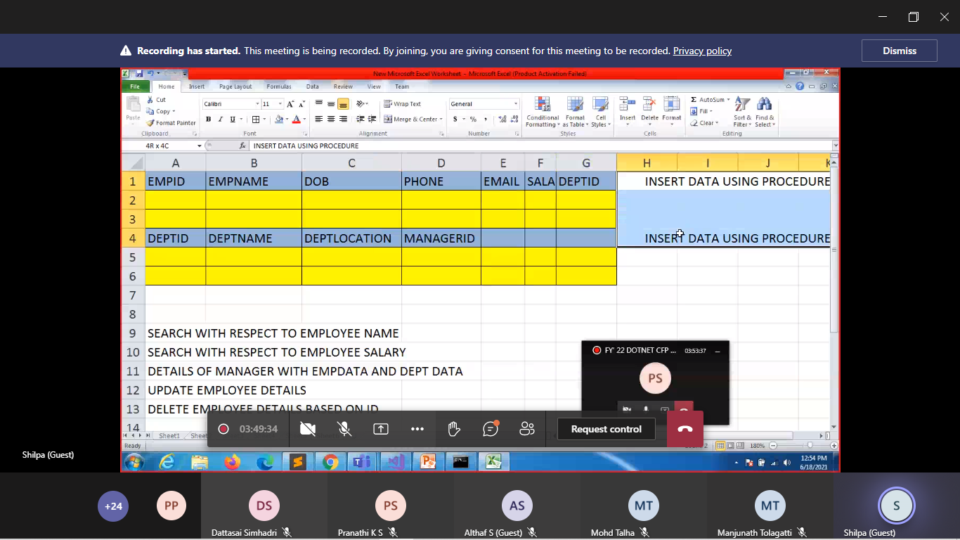
Establishconnection,Insert,Delete and update

Slide 7
Stored procedure for emp
CREATE PROCEDURE EMP_INSERT
(
@EMPID INT,
@EMPNAME VARCHAR(50),
@DOB DATE,
@PHONE VARCHAR(50),
@MAIL VARCHAR(50),
@SALARY FLOAT,
)AS
BEGIN
INSERT INTO EMPLOYEE VALUES(@EMPID,@EMPNAME,@DOB,@PHONE,@MAIL,@SALARY,@DEPTID);
END

Slide 8
CREATE PROCEDURE EMP_INSERT
(
@EMPID INT,
@EMPNAME VARCHAR(50),
@DOB DATE,
@PHONE VARCHAR(50),
@MAIL VARCHAR(50),
@SALARY FLOAT,
@DEPTID INT
)AS
BEGIN
INSERT INTO EMPLOYEE VALUES(@EMPID,@EMPNAME,@DOB,@PHONE,@MAIL,@SALARY,@DEPTID);END

Slide 9
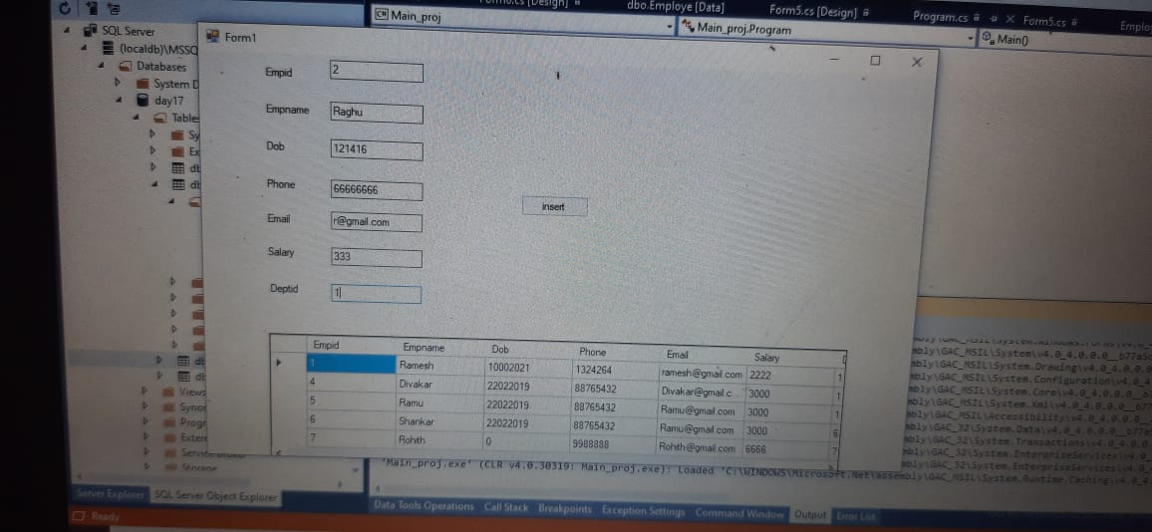
Inserting employee deatils

Slide 10
Stored procedure for dept
CREATE PROCEDURE DEPT_INSERT
(
@DEPTID INT,
@DEPTNAME VARCHAR(50),
@DEPTLOC VARCHAR(50),
@MGR_ID INT
)
AS BEGIN
INSERT INTO DEPT VALUES(@DEPTID,@DEPTNAME,@DEPTLOC,@MGR_ID);
END

Slide 11
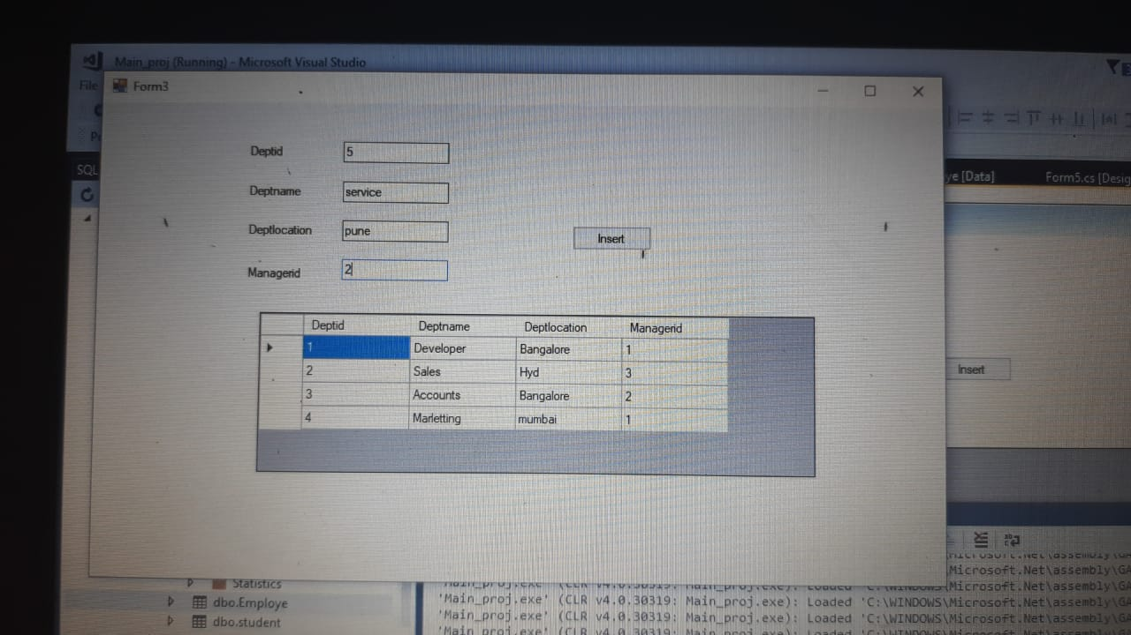
Inserting department details

Slide 12
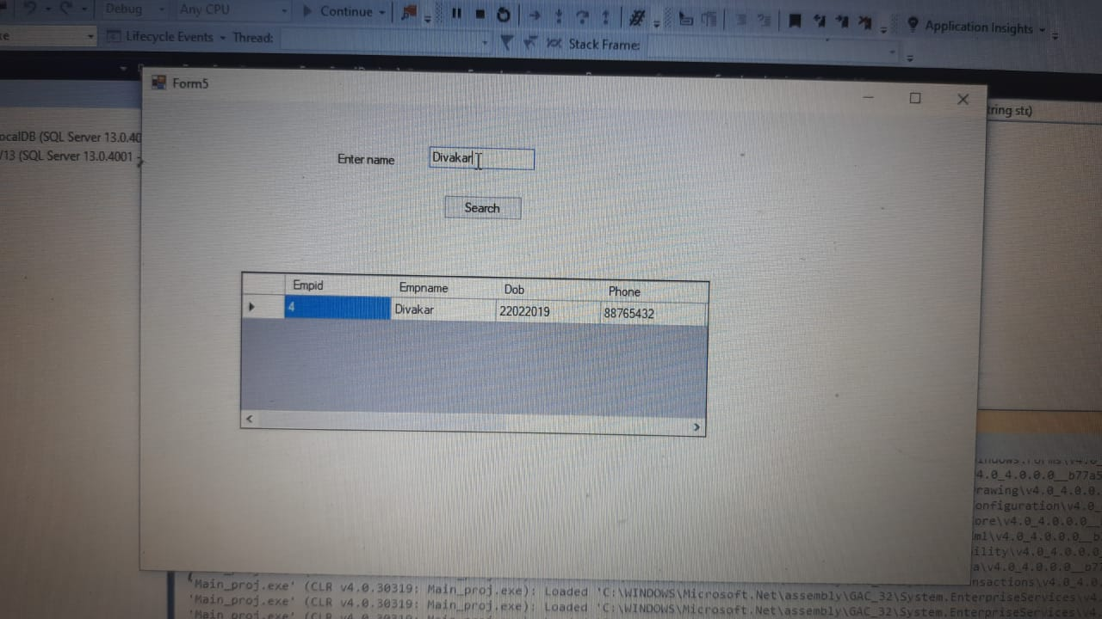
Search employee name

Slide 13
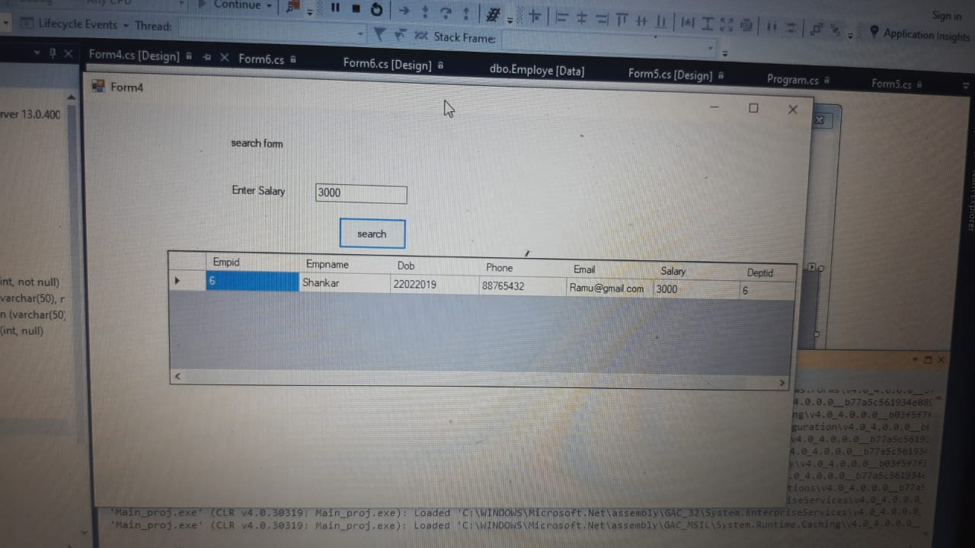
Search employee salary

Slide 14
Stored procedure for delete
CREATE PROCEDURE EMP_DELETE
(
@EMPID INT
)
AS
BEGIN
DELETE FROM EMPLOYEE WHERE EMPID=@EMPID;
END

Slide 15
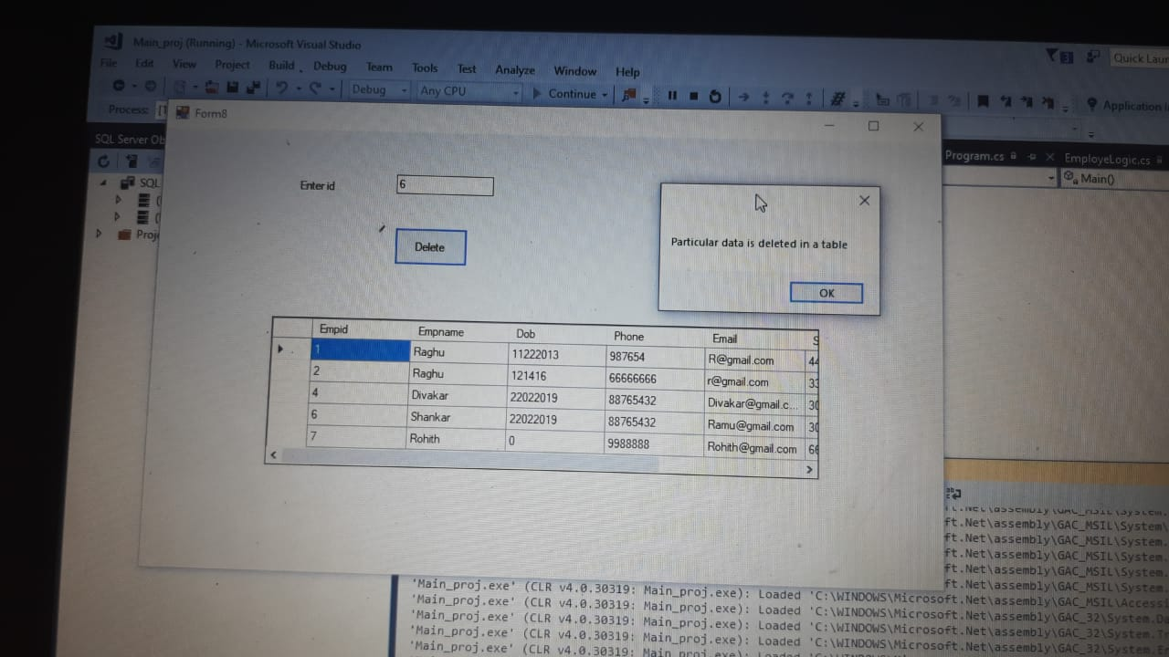
Delete emp details using empid

Slide 16
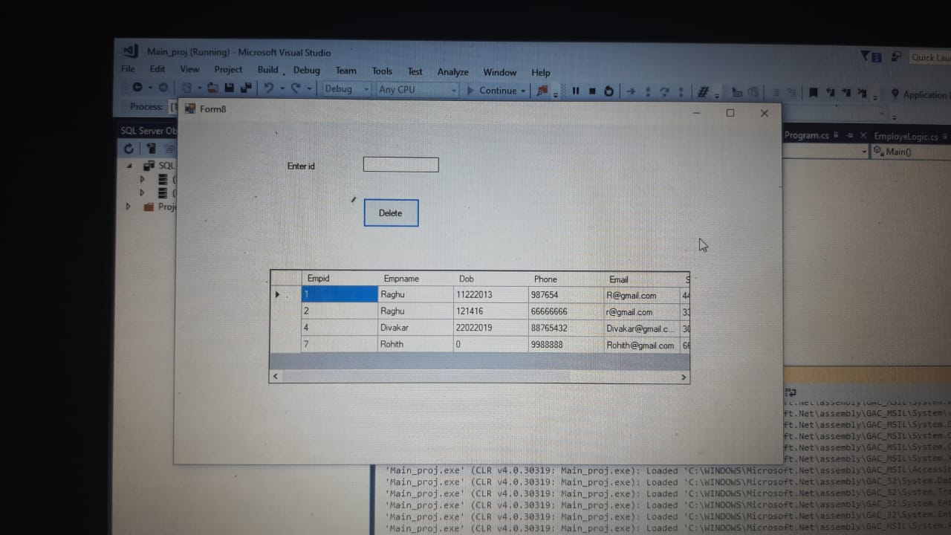
After deleting emp details

Slide 17
Stored procedure for update
CREATE PROCEDURE EMP_UPDATE
(
@EMPID INT,
@EMPNAME VARCHAR(50),
@DOB DATETIME,
@PHONE VARCHAR(50),
@MAIL VARCHAR(50),
@SALARY FLOAT,
@DEPTID INT
)AS
BEGIN
UPDATE EMPLOYEE SET EMPNAME=@EMPNAME,DOB=@DOB,PHONE=@PHONE,MAIL=@MAIL,SALARY=@SALARY,DEPTID=@DEPTID WHERE EMPID=@EMPID;END

Slide 18
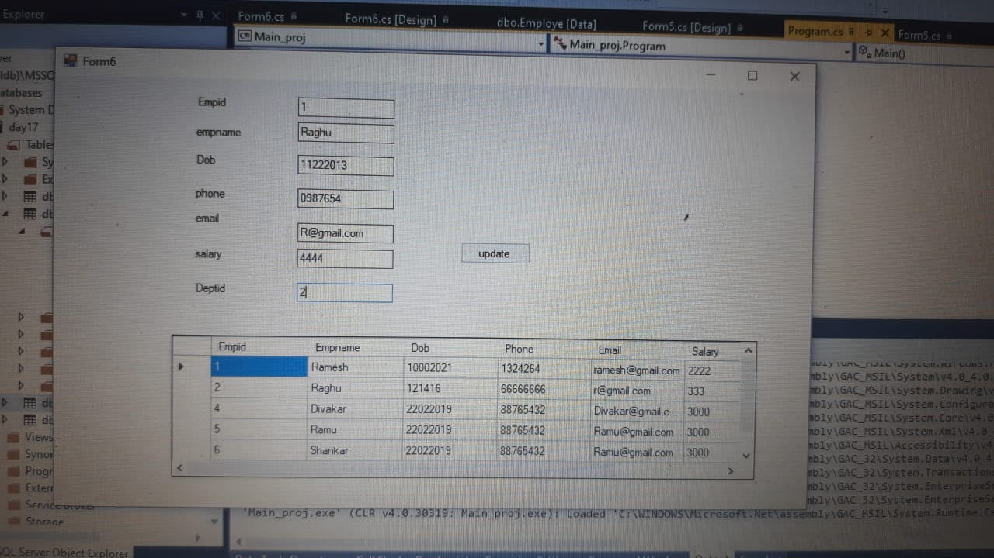
Update employee details

Slide 19
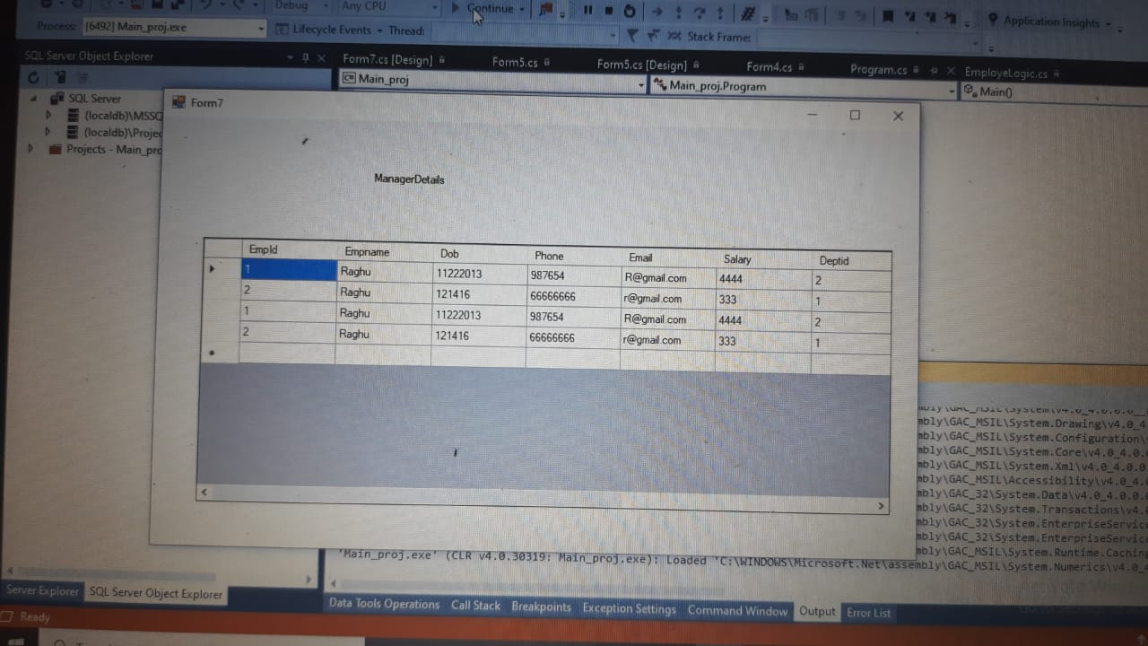
Details of manager with empdata and dept data

Slide 20



Our team
DASARAPALLI DIVAKAR
ASSOCIATE ENG. VIRTUSA
MADHURI KUNAM
ASSOCIATE ENG. VIRTUSA
JALLA MAMATHA
ASSOCIATE ENG. VIRTUSA

